Slide 1
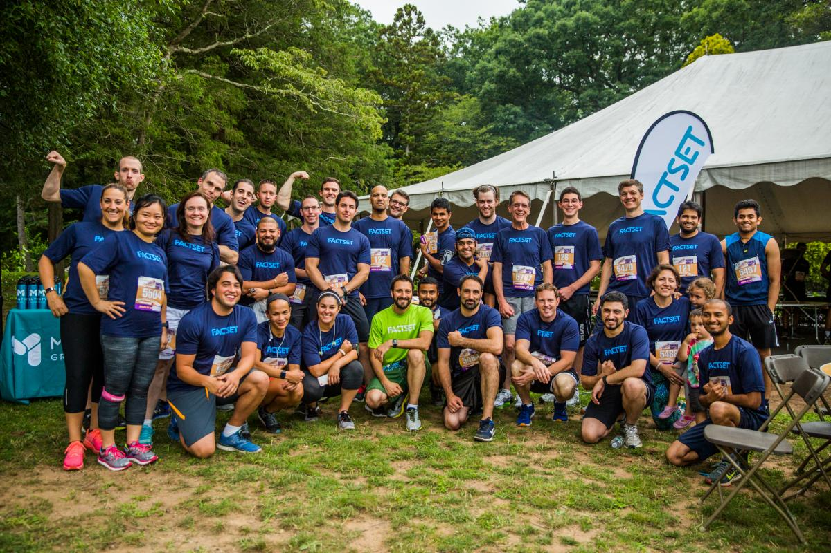
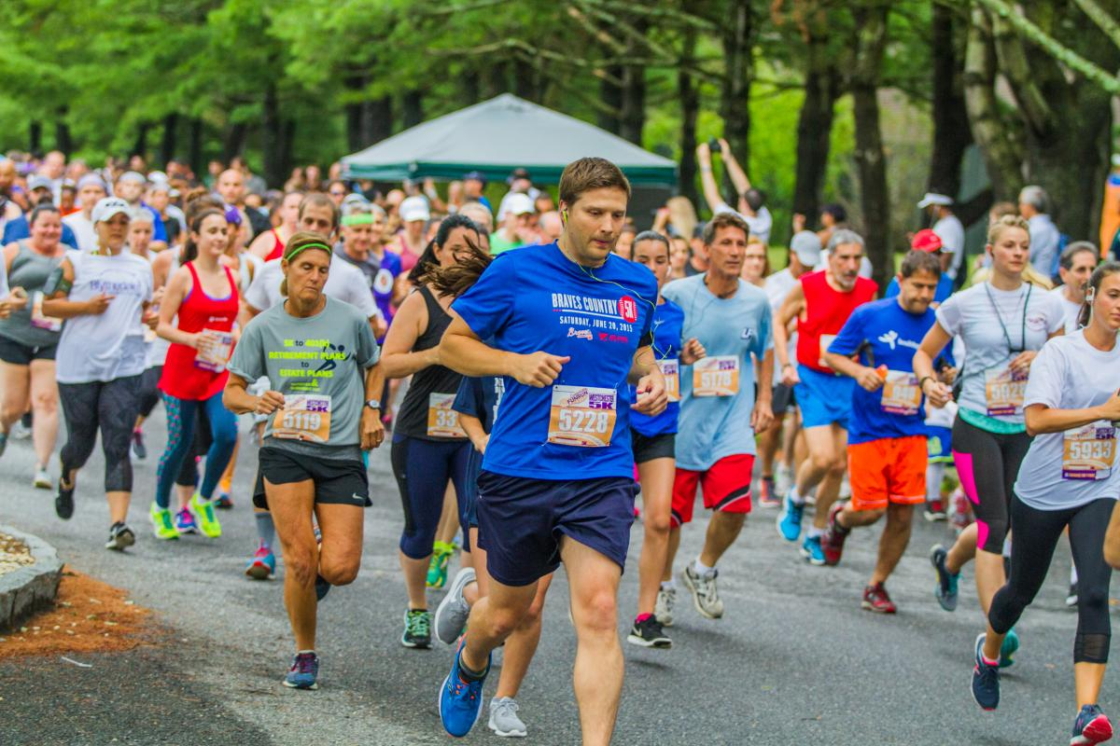
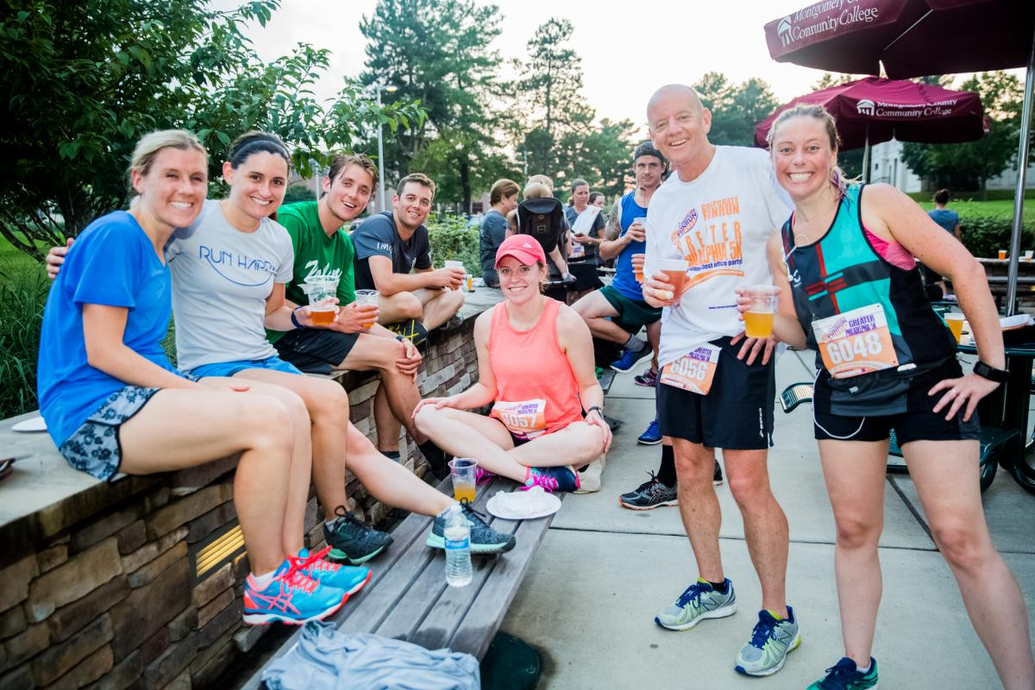
Sponsorship Proposal
Team Building Workplace Fitness Socializing and Fun
T

Slide 2
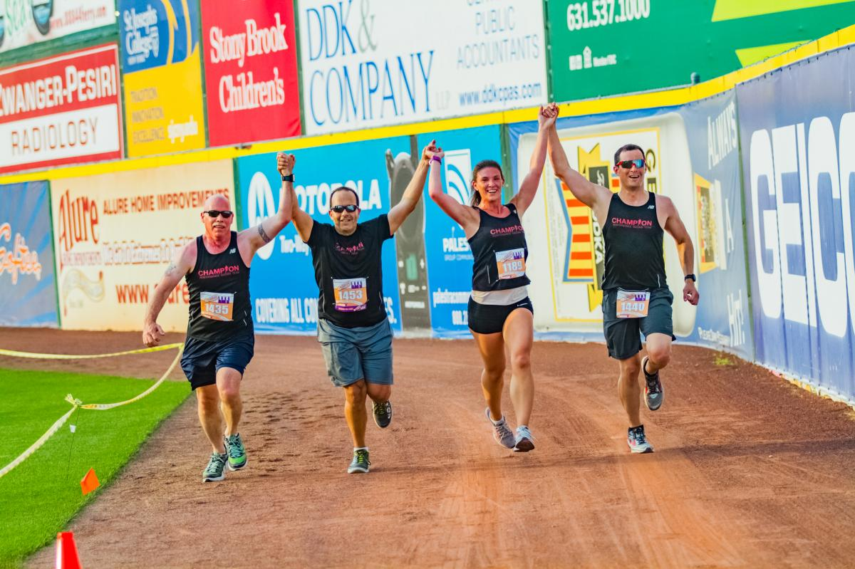
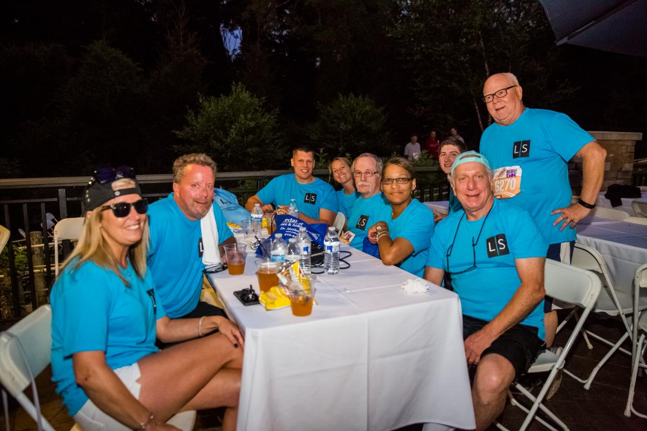
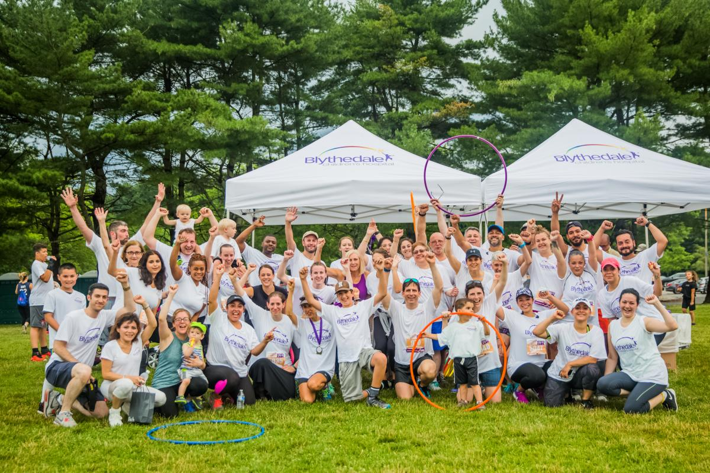
Who we are….
Corporate FunRun is the country’s leading organizer of summer-time, weekday evening company team based 5K (3.1 miles) running/walking events. Our events combine team building, workplace fitness and fun (beer-food-music)

Slide 3
Why Sponsor?
Increase brand exposure within large corporate geographies
Introduce products/services to leading companies through our team captain’s network
Introduce products/services to our well educated, upper income team members
Extremely targeted reach
Sponsorship helps activate team building & employee engagement internally

Slide 4
2019 Corporate FunRun Calendar 20 Great corporate markets to engage and connect with !!!
Baltimore
Boston
Cincinnati
Columbus
Delaware (Wilmington)
Fairfield County (Norwalk-Stamford)
Garden State (Union County NJ)
Jersey Capital
Lehigh Valley
Long Island
New Jersey (Essex/Morris County)
Northern New Jersey
Northern Virginia
Philadelphia
Pittsburgh
Research Triangle (Raleigh-Durham)
Southern Connecticut (Bridgeport – New Haven)
Washington D.C.
Westchester NY
Worcester MA

Slide 5
Event Demographics
Average age of participant is 40
57% female, 43% male
93% have college degrees, 39% have post-college degrees
100% of participating company teams are based within 15 miles of host venue
90% of participants live within 30 miles of host venue
The most represented industry sectors: Engineering, Manufacturing, Technology, Insurance, Accounting, Law, Health Care, Real Estate, and Advertising
Over 700 teams and 10,000 team members are expected in 2019

Slide 6
Sponsorship Deliverables
Category Exclusivity
Significant Brand Exposure
Networking and Data Base Access
E-Marketing
Race night Sponsor Booth and Messaging
Internal Team building and Employee engagement
Customized Activations

Slide 7
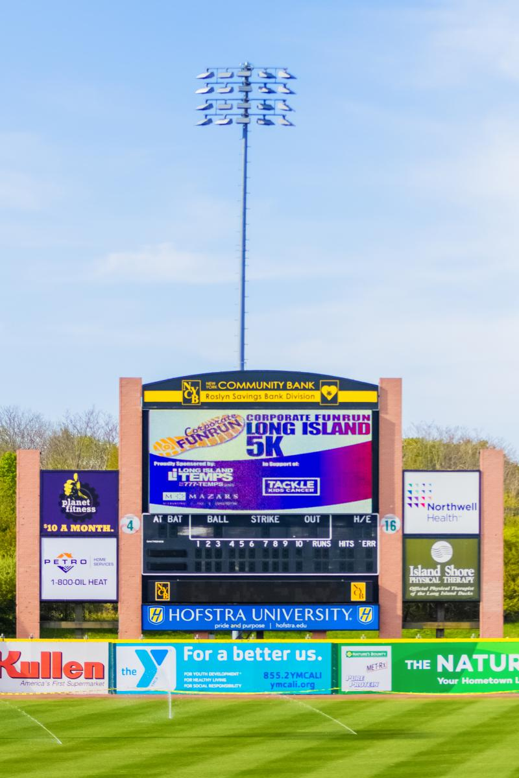
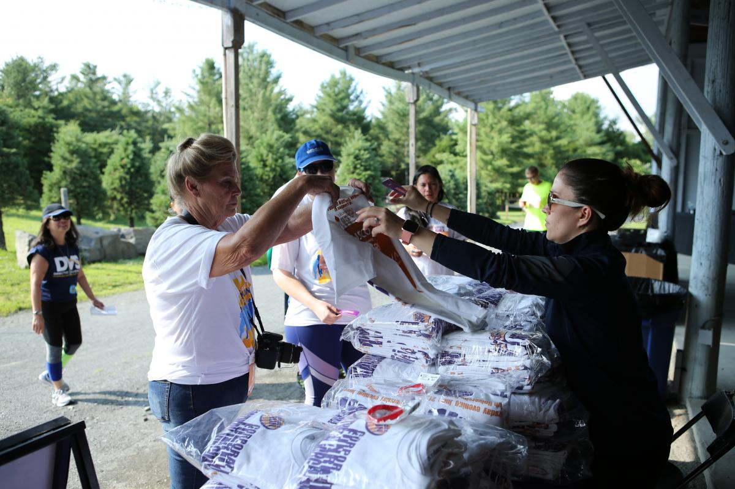
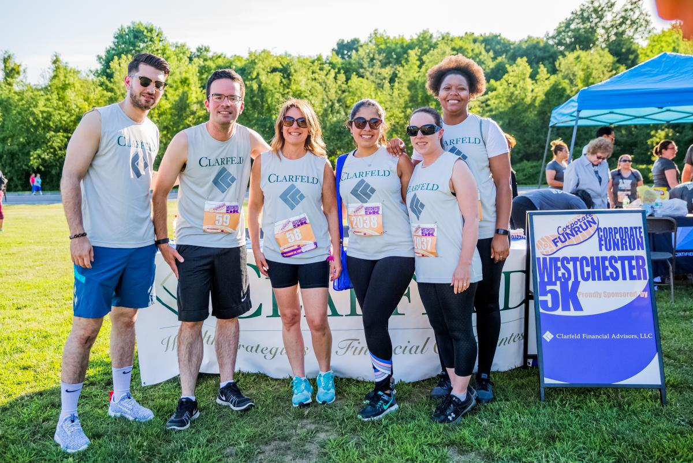
Deliverable Details
Category Exclusivity – only one sponsor per category
Significant Brand Exposure
Tee shirts Sponsor booth and A-frames Signage

Slide 8
Deliverable Details
Networking and Data Base
Sponsor Lunch – 2-3 months before event, CFR will host a sponsor only lunch near host venue to enable sponsors to get to know each other in an intimate setting.
Email Introductions – CFR will make email introductions between sponsors and demographically relevant team captains. This has proven extremely effective deliverable for many sponsors.
Networking Breakfast – 1-2 weeks before event, CFR will host a networking breakfast for all sponsors and team captains.
Weekly Company and Team Captain Data Base – beginning 3 months before event, sponsor will be provided the contact information for all registered teams and team captains. This is a unique B to B sales platform which will provide sponsors with numerous C-level connections.
Participant Data Base – within 3 weeks of event, sponsor will be provided the entire participant data base including name, age, occupation, company, and email address.

Slide 9
Deliverable Details
E-Marketing
Website Branding – sponsor logo prominently displayed in both the Sponsor Section of CFR website and frequently visited Events Page.
E-newsletter Branding – beginning January 2019 thru event night, sponsor logo is embedded into CFR weekly constant contact e-newsletter promoting event. Estimate 12 email newsletters, appx 3000 business email addresses, avg weekly open rate 20-30%, avg weekly click thru rate 5-10%.
Race night Connections with event participants
Sponsor Booth - in the sponsor zone on event night. Sponsor booth includes 8 foot table and chairs to activate with race night participants via product samples, promoting expertise, distributing literature, and making personal connections.
Event Night Messaging – Event night announcer repeatedly thanks Sponsors by name and delivers customized sponsor messaging throughout event night.

Slide 10
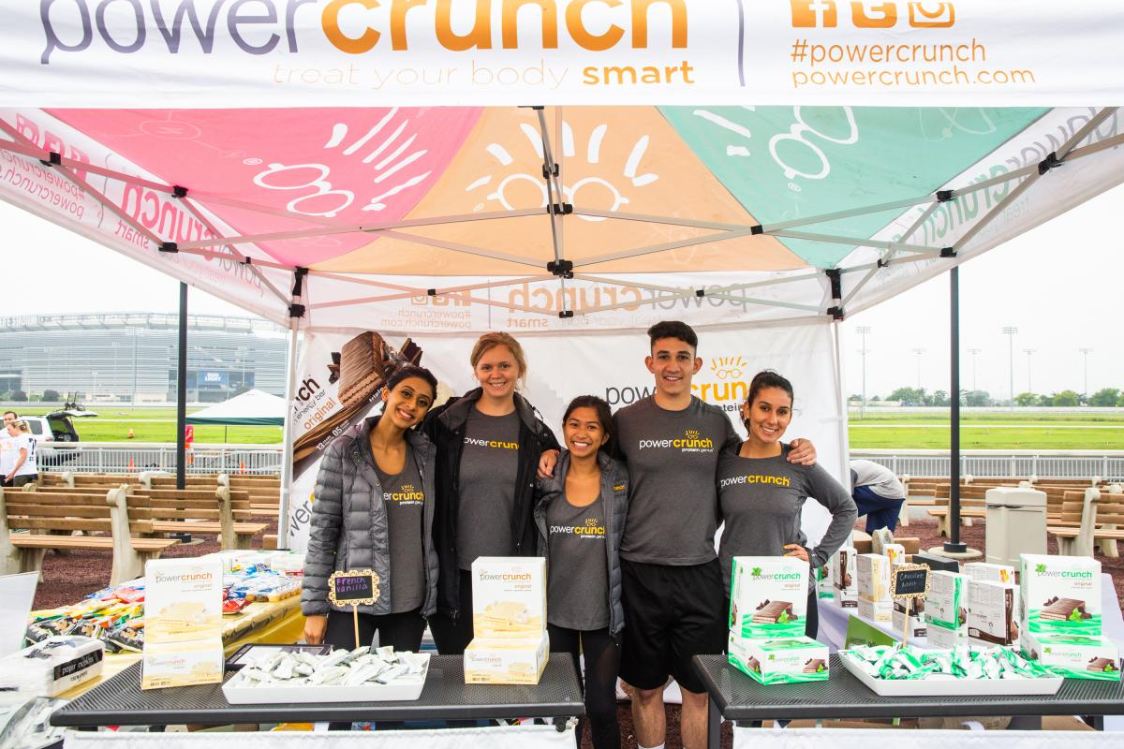
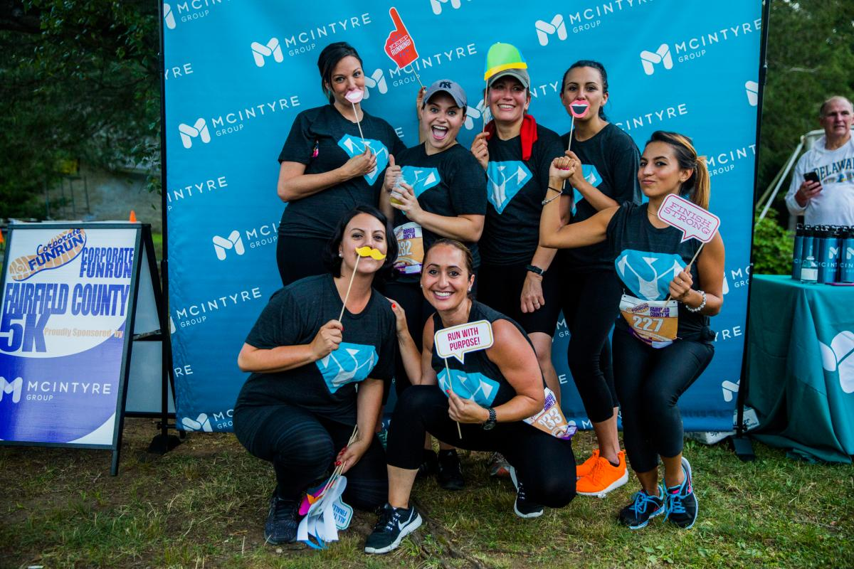
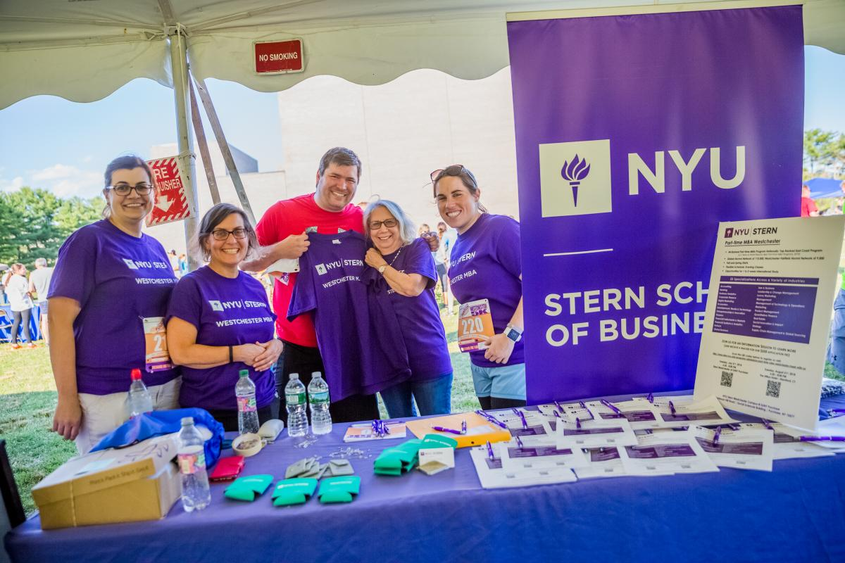
Deliverable Details
Customized Activations
Photo Booth
Product Sampling
Distributing literature on services

Slide 11
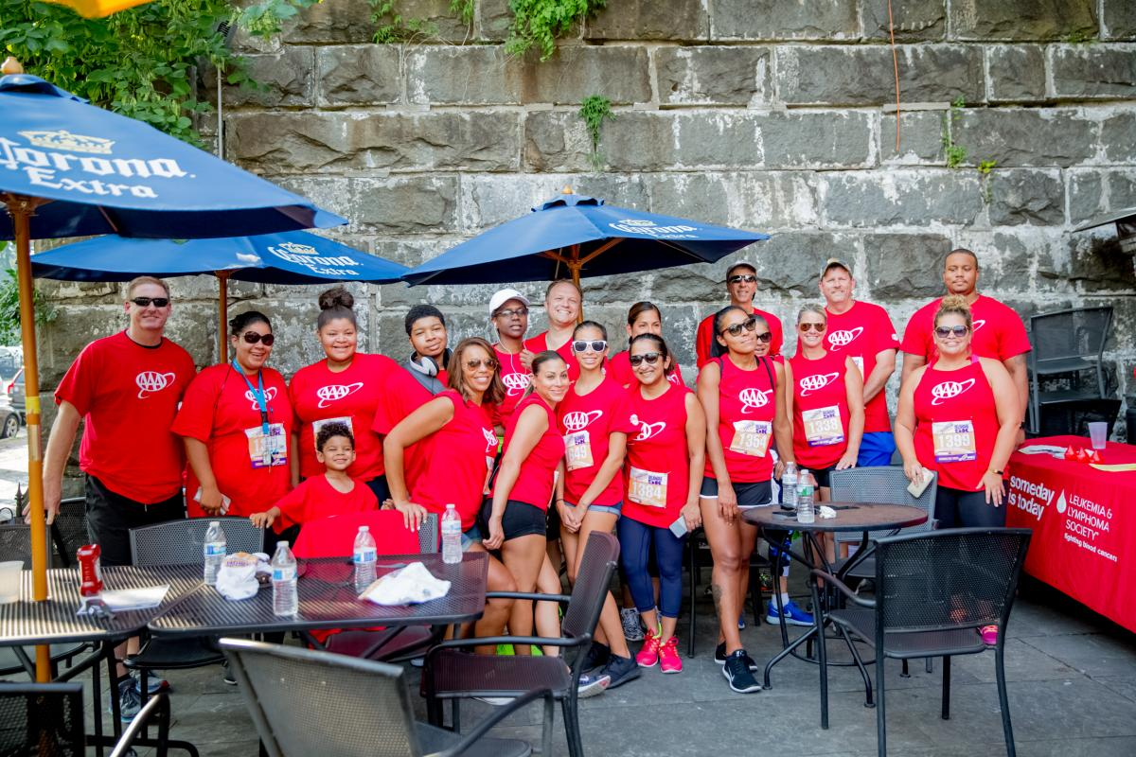
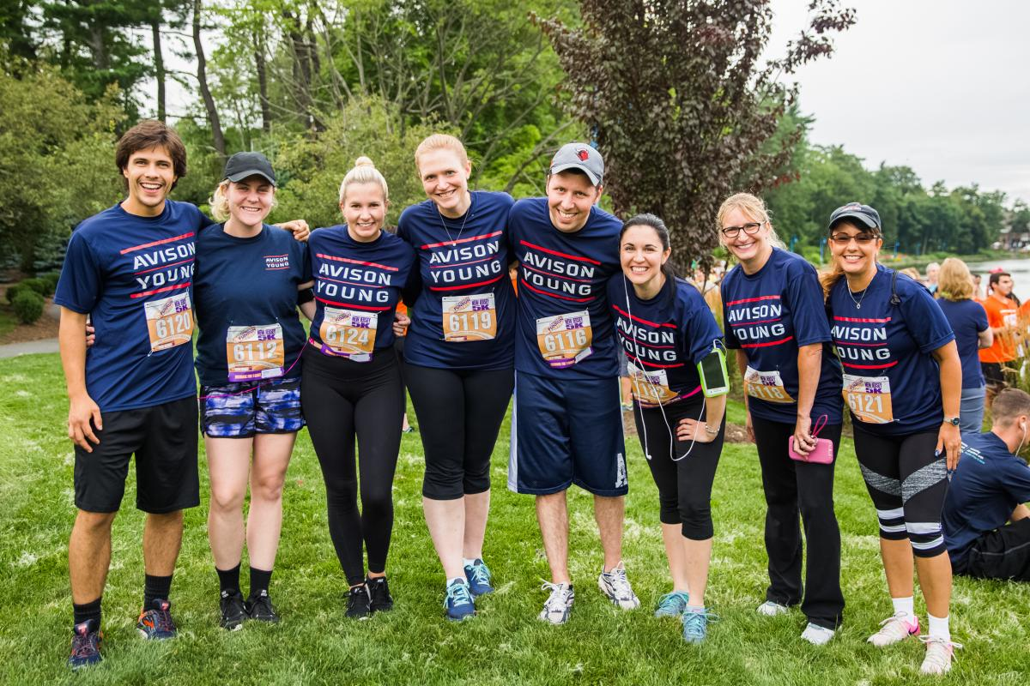
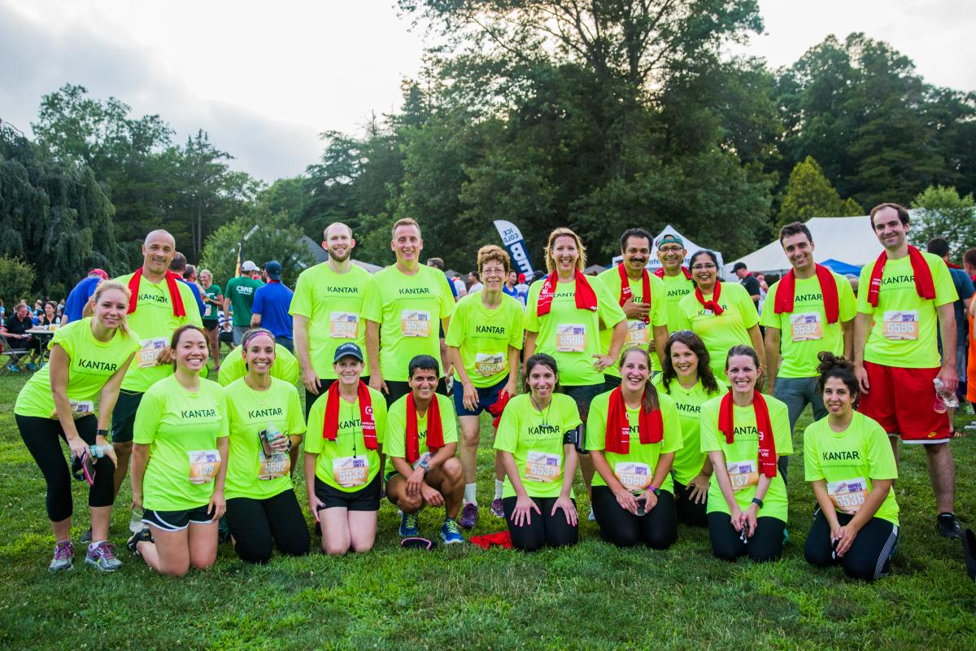
Deliverable Details
Sponsorship helps activate Team Building and Employee Engagement

Slide 12
For questions or to set up a meeting to review sponsorship opportunities please contact: Bruce Pienkny Phone: (347) 844-9687 Email: BruceP@CorporateFunRun.com

